Slide 1


Strategies for Promoting Academic Success Among First-Generation Social Work Students
Lamont Simmons, EdD, MSW
Kenya Anderson, LMSW
Susan Neely-Barnes, PhD, MSW
Notes:
Introductions

Slide 2

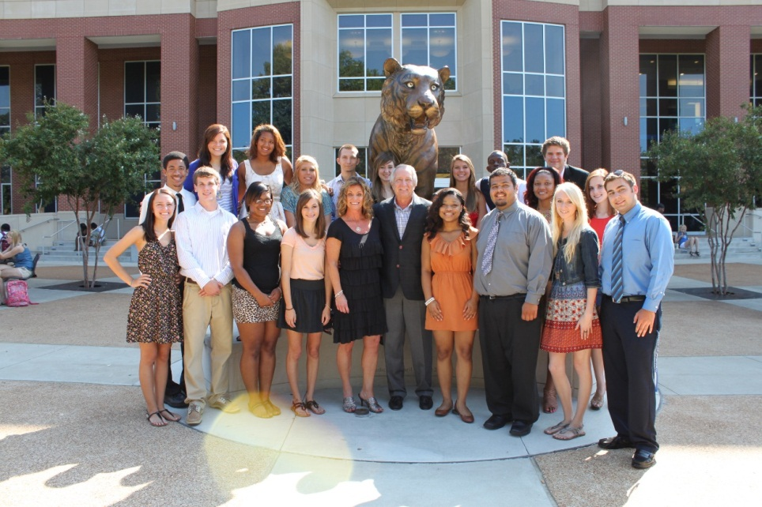
Who are First Generation Students?
Notes:
TRIO defines first generation as a student whose parents have not obtained a post-secondary degree (Ward, Siegel, & Davenport, 2012).
Billson and Terry (1982) devised the term first-generation college students to describe those students for whom neither parent attended a baccalaureate institution.

Slide 3
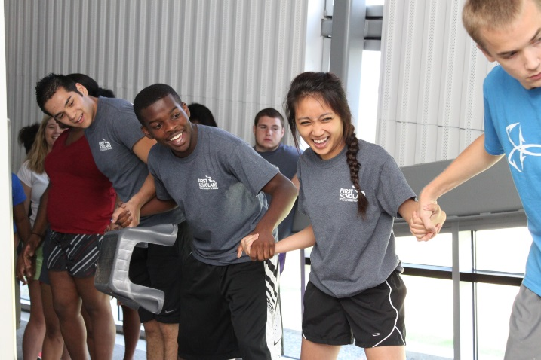
Demographics
First generation college students are more likely to:
Be African-American, American Indian, Hawaiian/Pacific Islander, or Latino.
Be older than traditional age.
Come from low income families.
Attend part-time.
Live off-campus.
Work while attending school.
Drop out/Stop out.
Source: Balemian & Feng, 2013

Slide 4
Unique Challenges
First Generation students have the following unique challenges:
More likely to delay college
More likely to need remedial coursework
Report lower educational expectations than their peers
Often begin college less academically prepared
More likely to focus on vocational/technical fields
Source: Balemian & Feng, 2013

Slide 5
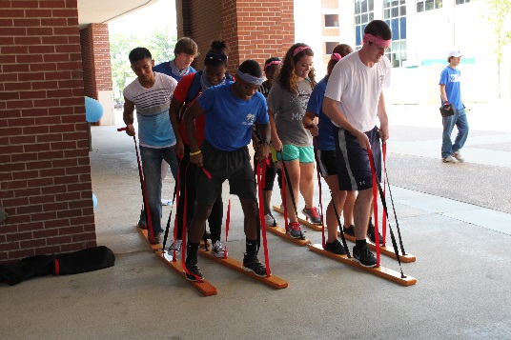
Unique Challenges
Limited access to information about the college experience
Lack of knowledge about time management, college finances, budgeting and the bureaucratic operations of higher education
Absence of support due to a cultural conflict between home and college communities

Slide 6
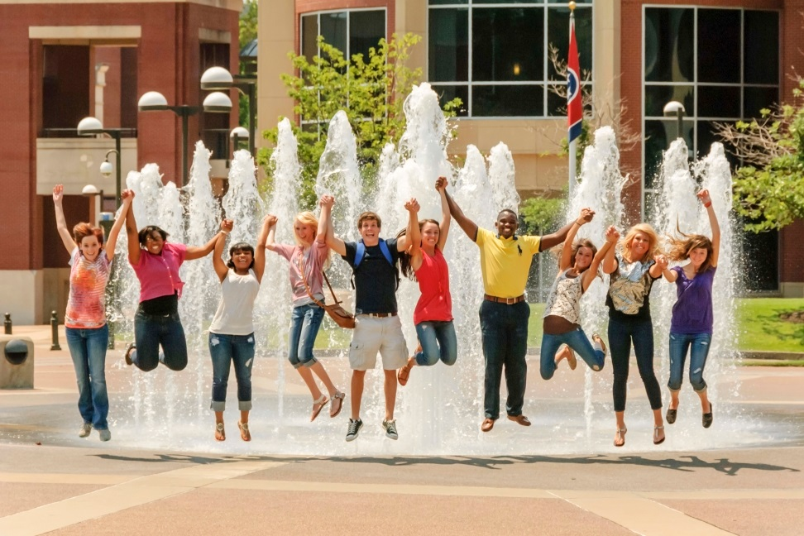
Unique Challenges
Susceptibility to doubts about academic abilities
Perception that they are “not college material” causing decreased motivation
Struggle to maintain balance between work, family and school responsibilities

Slide 7
Social/Cultural Capital & First Generation
Social Capital – the networks of relationships among people who live and work in a particular society enabling that society to function effectively (Portes, 2000).
Cultural Capital – non-financial social assets that promote social mobility beyond economic means (i.e.. education, intellect…) (Throsby, 1999).
First generation students do not have the social/cultural capital of continuing generation students.

Slide 8
12th Grade Students Intention To Complete College
Parent Education Level
Source: Aud, et al, 2012

Slide 9
National Graduation Rates
The first-generation student population is growing, yet they are not making up a higher percentage of graduates.
Source: The Condition of Education, 2012 NCES

Slide 10
First Generation Students In Social Work
Lack of research on first generation students in social work.
High percentage of social work students (46.1%) are from historically under-represented racial/ethnic backgrounds (CSWE, 2013).
It is likely that a high percentage of social work students are first generation. More research is needed.

Slide 11
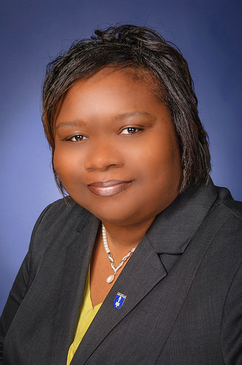
First-Generation Student Personal Experience
Kenya Anderson, LMSW
Notes:
Kenya - Personal case experiences (10 minutes)

Slide 12
Group Discussion
What difficulties do first-generation students in your undergraduate social work program encounter during their educational experiences?
What program policies or practices are employed for enabling these students to overcome their difficulties?
Discuss additional resources that your program uses to enhance graduation attainment among first-generation social work students?
Notes:
Lamont - Facilitate discussion (25 minutes)
Scribe needed to capture responses on flipchart paper?

Slide 13
Effective Strategies
Summer bridge or early intervention programs
Mentoring
Strengthening social supports
Group interventions with first generation students
Academic coaching or tutoring
(Barefoot, 2004; Institute for Higher Education Policy, 2012; Strand, 2013; Swail, 2004)
Notes:
Kenya - Summary of Discussion (10 minutes)

Slide 14
References
Aud, S., Hussar, W., Johnson, F., Kena, G., Roth, E., Manning, E. et al. (2012). The Condition of Education 2012. National Center for Education Statistics. Retrieved September 11, 2014 from: http://nces.ed.gov/pubs2012/2012045.pdf
Balemian, K. & Feng, J. (2013, July 19). First generation students: College aspirations, preparedness and challenges. Presentation to the College Board AP Annual Conference.
Barefoot, B. O. (2004). Higher education's revolving door: Confronting the problem of student drop out in U.S. colleges and universities. Open Learning, 19(1), 9-18.
Council on Social Work Education (2013). 2013 Annual Statistics on Social Work Education in the United States. Retrieved August 26, 2015 from: http://www.cswe.org/File.aspx?id=74478

Slide 15
References
Hodges, J.Q. (2000). First-generation college students in an undergraduate social welfare program: Issues, interventions, and implications. The Journal of Baccalaureate Social Work 6(1), 37-51.
Institute for Higher Education Policy. (2012, September). Supporting first- generation college students through classroom-based practices. Washington, DC: Author.
Strand, K.J. (2013). Best practices for ensuring the academic success of first-generation college students. Washington DC: Council of Independent Colleges.
Swail, W. S. (2004). The art of student retention: A handbook for practitioners and administrators. Educational Policy Institute. Texas Higher Education Coordinating Board 20th Annual Recruitment and Retention Conference, Austin, TX June 21, 2004. www.educationalpolicy.org

