Slide 1

Congressional Staff Network Memphis Site Visit
Elena Delavega, PhD, MSW
February 21, 2019
Data from
US Census Bureau 5-Year estimates (2011-2015) for Shelby County. Economic and Social Characteristics.
US Census Bureau 1-Year Estimates (2017) for the United States, Tennessee, Shelby County, Memphis, TN, and the Memphis MSA. Social Characteristics.

Slide 2

Poverty Rates
2017 | Overall | Under 18 | 18 to 64 | Over 65 | Non-Hisp. White | Non-Hisp. Black | Hispanic or Latino | Asian
United States | 13.4% | 18.4% | 12.6% | 9.3% | 9.6% | 22.9% | 19.4% | 11.0%
Tennessee | 15.0% | 21.2% | 14.2% | 9.2% | 12.1% | 24.3% | 24.5% | 10.6%
Shelby County, Tennessee | 18.8% | 30.2% | 15.9% | 10.5% | 8.0% | 25.4% | 30.1% | N/A
Memphis city, Tennessee | 24.6% | 39.0% | 20.7% | 14.2% | 12.3% | 28.9% | 33.3% | N/A
Memphis, TN-MS-AR Metro Area | 17.1% | 27.1% | 14.6% | 9.8% | 8.1% | 24.5% | 29.4% | N/A

Slide 3
2017 Percent of the population in poverty, by region

Slide 4
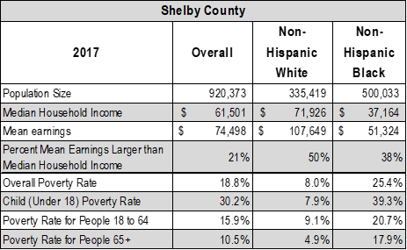

Slide 5
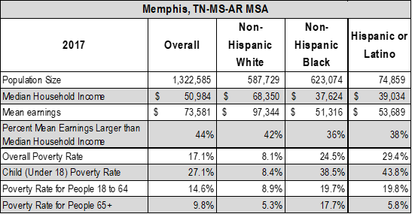

Slide 6
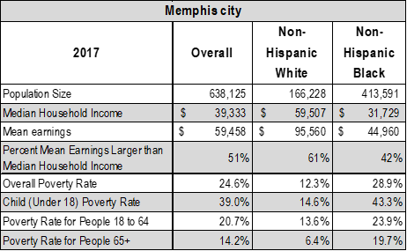

Slide 7
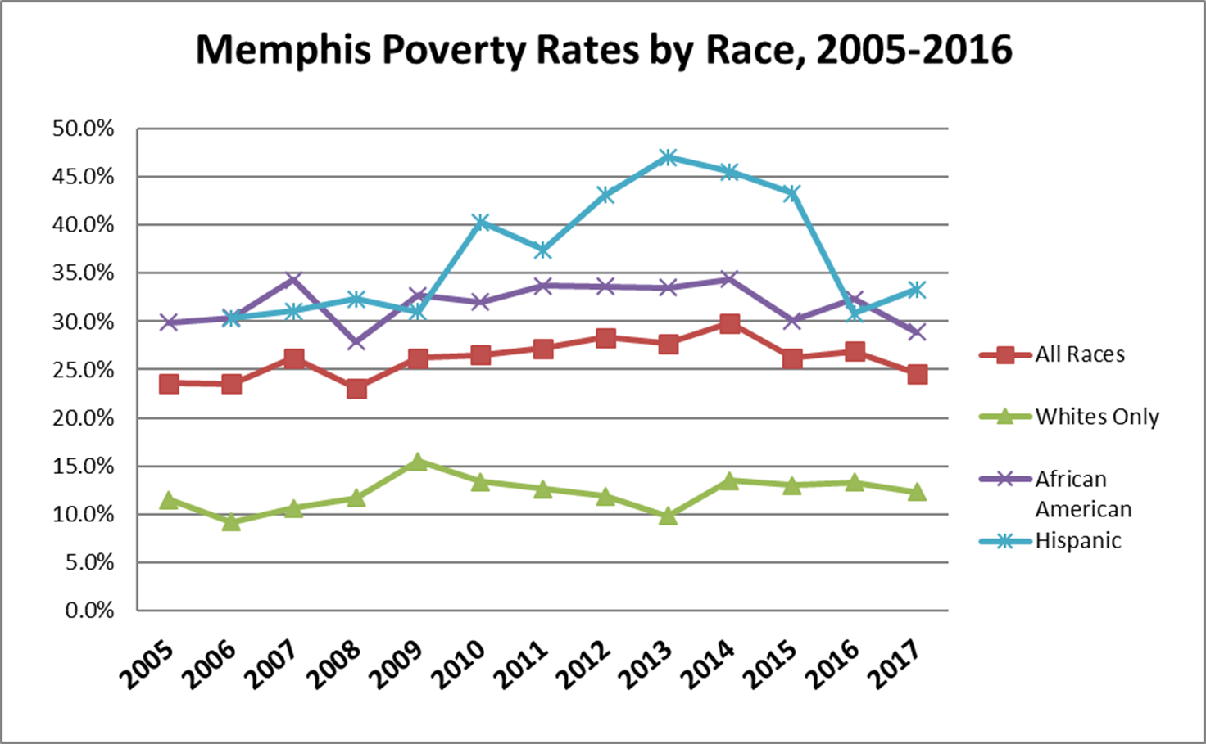

Slide 8
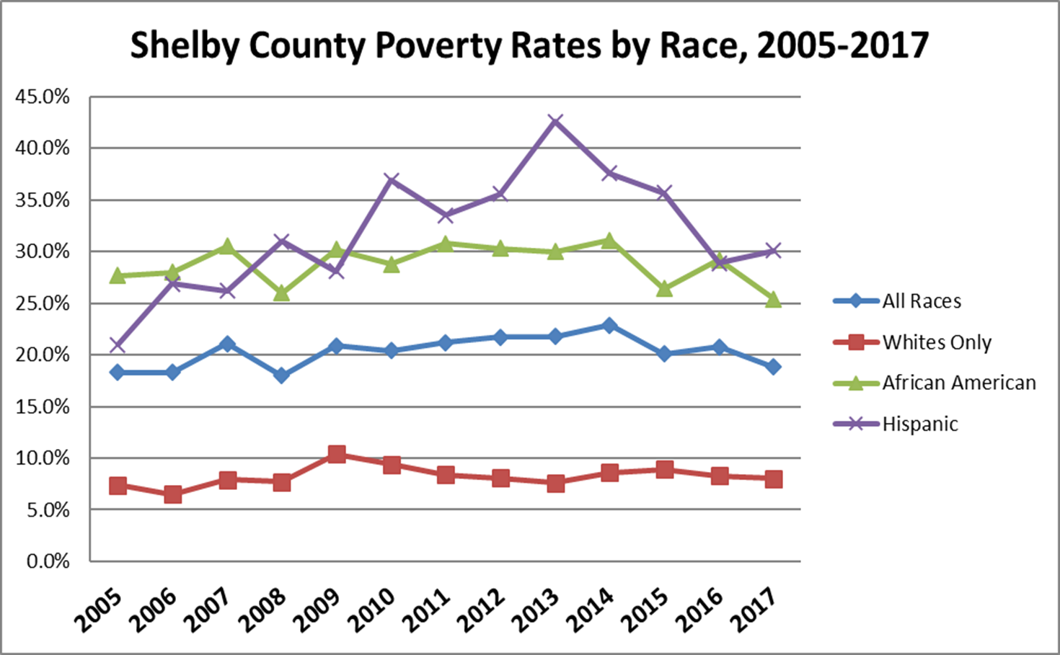

Slide 9
THE EMPLOYED POPULATION IN SHELBY COUNTY

Slide 12
Shelby county occupations

Slide 14
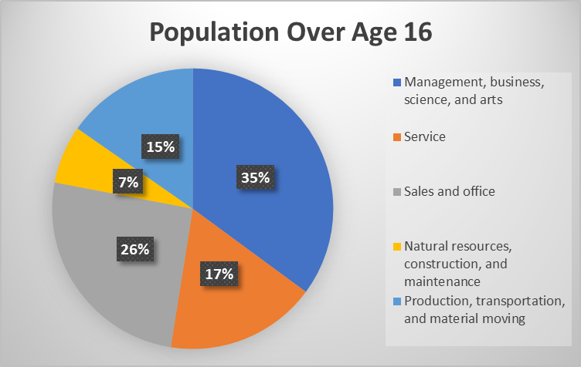

Slide 15
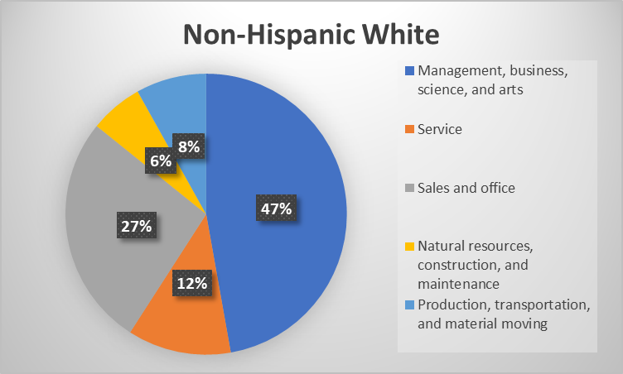

Slide 16
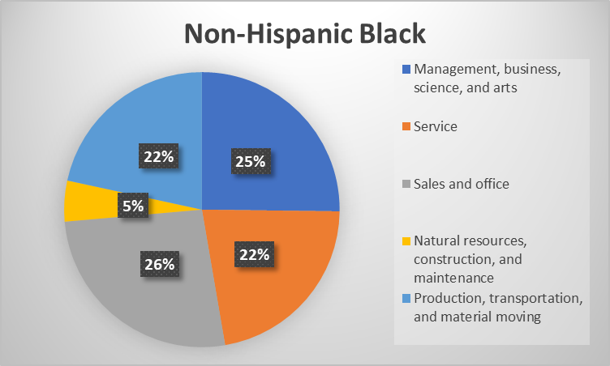

Slide 17
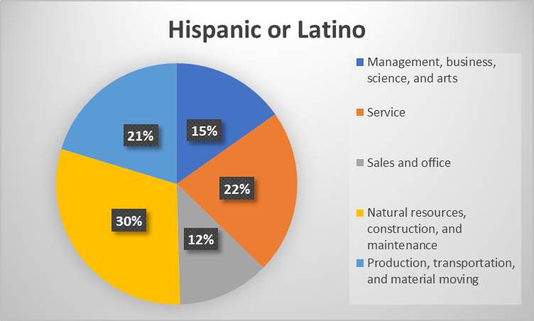

Slide 18
Shelby county earnings

Slide 19
2017 U.S. Poverty Guidelines
PERSONS IN FAMILY/HOUSEHOLD | POVERTY GUIDELINE
For families/households with more than 8 persons, add $4,180 for each additional person.
1 | $12,060
2 | $16,240
3 | $20,420
4 | $24,600
5 | $28,780
6 | $32,960
7 | $37,140
8 | $41,320
FOR CONTEXT

Slide 21
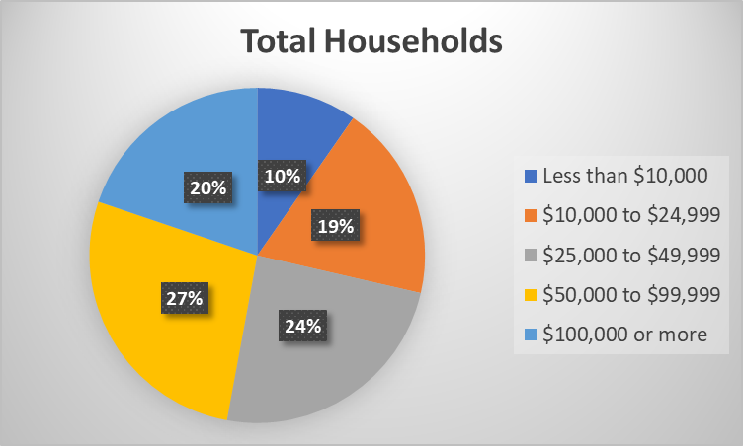

Slide 22
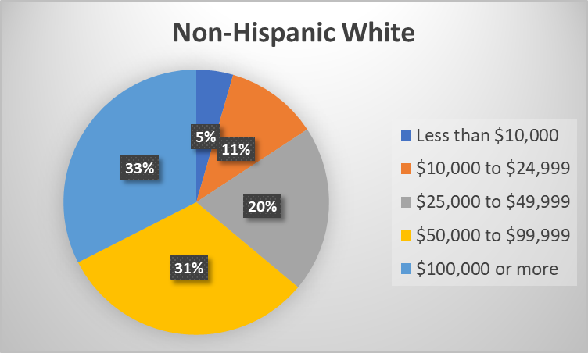

Slide 23
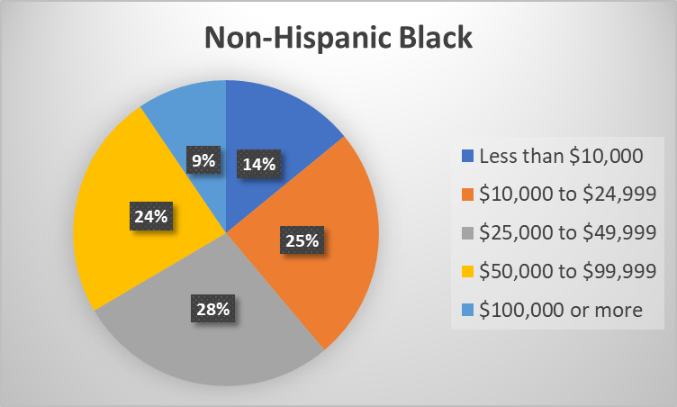

Slide 24
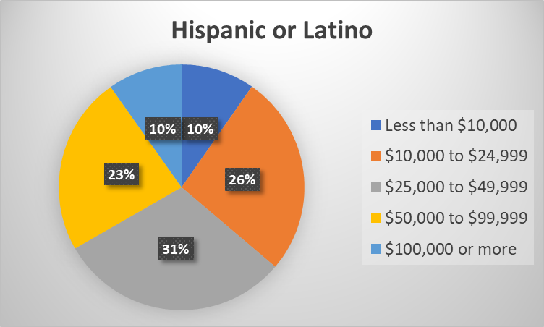

Slide 25
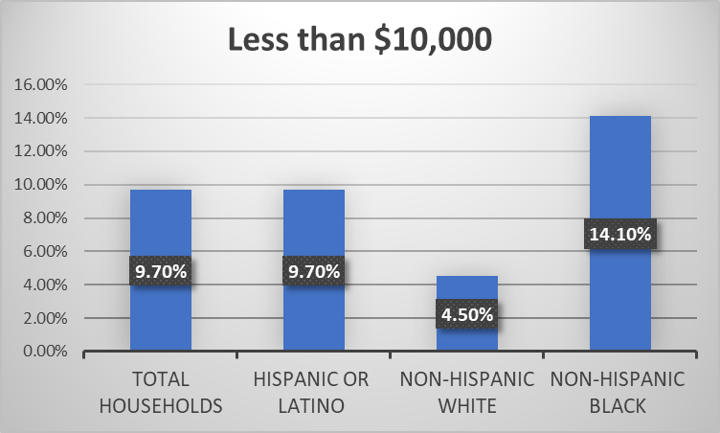
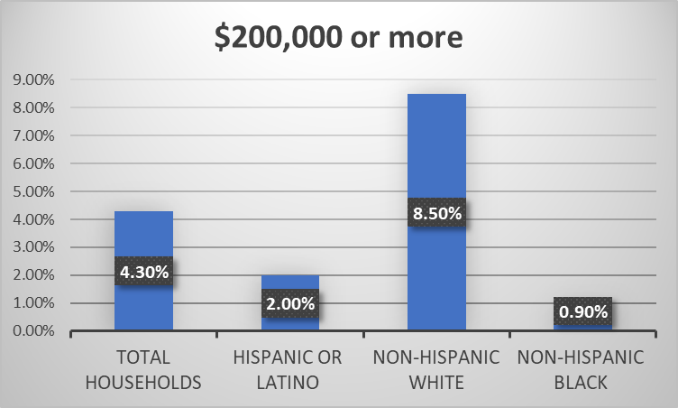
THE EXTREMES

Slide 27
LOW WAGES ARE A HUGE ISSUE IN SHELBY COUNTY

Slide 28
THE POPULATION IN SHELBY COUNTY NOT IN THE LABOR FORCE

Slide 31
The number that matters is
50,751
DISENGAGED PERSONS

Slide 32
Thank you!
  For more information, please contact
  Dr. Elena Delavega
  School of Social Work
  University of Memphis
  mdlavega@Memphis.edu

