Slide 1
Project RAISE: Rural Access to Interventions in School Environments
Dr. April Ebbinger, Director of School Psychology Services

Slide 2
2nd
Suicide is the second leading cause of death for Tennessee youth and 10.6 percent of Tennessee youth reported attempting suicide in the last 12 months as compared to 8.9 percent nationally.
45th
Tennessee is experiencing dramatic shortages of school-based mental health providers and is currently ranked 45th in the country for access to mental health care.
15%
Through a targeted and systematic framework for supervision and mentorship, the project aims to increase retention of mental health providers in rural districts by 15 percent.
300
Over the five-year grant, these efforts will recruit and retain over 300 mental health providers across 40 rural Tennessee school districts.
10%
This project intends to increase the recruitment of mental health providers in rural communities by 10 percent.

Slide 3
School Social Work Need (2018)

Slide 4
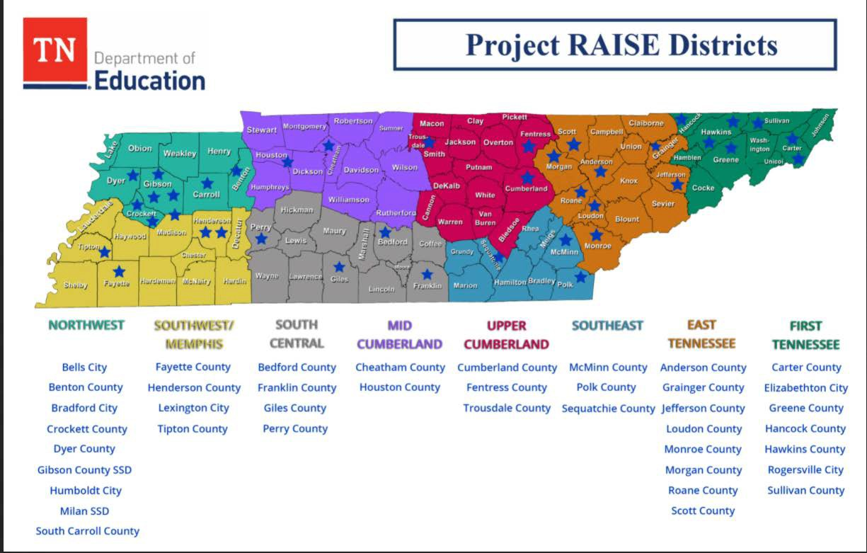
Project RAISE
Awarded $13,780,842 to recruit and retain school psychology, school counselor, and school social worker internship candidates

Slide 5
Project RAISE
TDOE School Counseling and School Social Work Coordinators
Stipends for interns
Stipends for supervisors
Relocation assistance

Slide 6
Requirements for Stipends
School Social Work Student Interns
Must inform their university of this interest, and must complete an application with TDOE to be entered for stipend payments
May need proof of GPA in Bachelor’s program to qualify for the TEP program (this is a university requirement for some);
Proof of being currently enrolled, attending and in good academic standing in a CSWE accredited social work graduate program (MSW, MSSW)- (this can be in the form of a letter from your field director/program coordinator);
Proof of the completion of or concurrently taking, school social work specific graduate level content from an approved university as a pathway towards school social work licensure in the state of TN-(sample current transcript may be requested);
Must be in your second year (clinical year)/ or advanced standing in the MSW program, with one (1) year of completed fieldwork in an accredited Social Work Program. Previous field experience in working with children, youth and adolescents is a plus- (this can be in the form of a letter from your field director/ or university approval);
You will be required to complete at least 460 direct service/ internship specific in school-based practice in a school setting to be eligible for this internship and complete all remaining internship hours above and beyond the required 460 hours if determined by your graduate level program. For example, most MSW programs require students to complete 600 hours of field hours from August-May. Also, be aware that school internships are typically 8:00-3:00 internship hours and require this level of availability;
Must do field placement in one of the identified districts on map (may include travel or relocation);
If accept the stipend the student MUST work at the identified school one-year post-graduate, and complete a second year in ANY school in state of TN
Must attend an annual supervisee/ intern onboarding process in Summer

Slide 7
Project RAISE
University programs will follow their own processes for vetting new field placements in these school districts and establishing working MOUs/ Affiliations.
University programs will follow their own processes for vetting students for field placements in these schools and ensuring they meet the criteria for the Project RAISE Stipend annually.
University programs will follow their own processes for vetting Field Instructors/ Supervisors for supporting their interns in these identified locations.
University programs will follow all accreditation standards and guidelines, and bring to the attention of the Project RAISE team if anything appears to be not aligned with accreditation standards for purposes of adjusting program as needed.
If the university is struggling with identifying a Supervisor/ Field Instructor for a region or location, the Project RAISE program may assist with identifying a possible candidate.
Although we would love to have Field Instructors identified who have experience in school social work (working in a school setting) or even Licensed as a School Social Worker in the state, we understand that there is a shortage. The university may use a vetted supervisor who is within the local area or nearby to the identified school placement and utilize this Field Instructor for supporting the student in a school (Field Instructors will attend an annual training for support in supervising School Social Work students in a rural region)
Please consider the Field Instructors ability to provide 1 hour a week of direct supervision with the student intern, and their ability to be on site for support and skill observation/ development of the student. Project RAISE encourages Field Instructors to be accessible on site but understands the need for possible remote supervision as well.
Many student interns and field placements will be NEW to hosting a school social worker, so the identified Field Instructor will also need to assist the student intern in providing oversight on program development and service delivery within these new spaces (this is something to inform the potential field instructor)

Slide 8
Suggestions for identifying Supervisors/ Field Instructors
School Social Work Supervisors/ Field Instructors
May need to be identified as a possible supervisor/ Field Instructor with support of TDOE IF in a region where there are no currently existing Supervisory/ Field Instructors for the identified university
Must be connected with the local university as a field supervisor/ supervisor and must follow all university and accreditation requirements set forth by the university (the university officially vets and accepts the field instructors/ supervisors for this work)
Field Instructors must have an MSW degree from an accredited university, with 2 years post-graduate experience is a REQUIREMENT! Would be beneficial if the Field Instructor/ Supervisor has an active School Support Personnel Licensure in School Social Work in TN; Licensed Master Social Worker (LMSW) in TN; or a Licensed Clinical Social (LCSW) .
Another preference would be previous knowledge of and experience in School Social Work field, working directly in a school, and working with children, youth, and families; proof of previous supervisory responsibilities in the past is also preferred.
We would encourage that programs support their Field Instructors in obtaining supervision specific training, through annual Field Instructor trainings and encourage additional professional development and/ or continuing education in supervision practices in social work. The Project RAISE program will provide some additional training in this area at the annual Summer cohort training event.
We would encourage you to obtain the Field Instructors resume or Curriculum Vita
The identified Project RAISE supporting Supervisors/ Field Instructors, must attend an annual onboarding and supervisor training (Typically in July)

Slide 9
Project Partners
MTSU University of Memphis University of Tennessee, Chattanooga
University of Tennessee, Knoxville
Contact us at ProjectRAISE@utk.edu

