Slide 1

University of Memphis
Department of Social Work
Social Work Open House
September 13, 2017

Slide 2


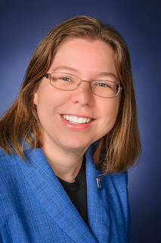
WELCOME
FROM THE DEPARTMENT CHAIR
Dr. Susan Neely-Barnes

Slide 3
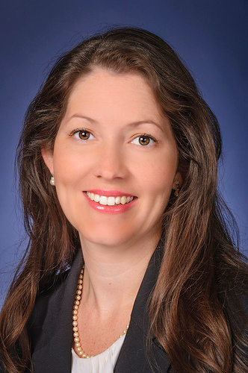
Social Work Open House
Purpose and Objectives
Dr. Susan Elswick
BA Program Coordinator

Slide 4


Purpose of the Seminar
Review of Social Work programming
Overview of the curriculum and field practice
Review Social Work Campus Supportive Services
Discuss the profession of Social Work
Answer questions about our programming and the field of Social Work

Slide 5
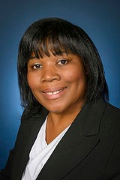
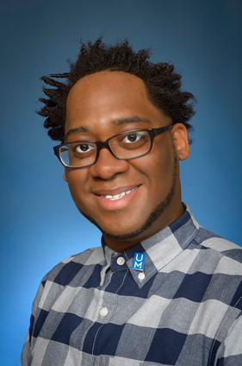
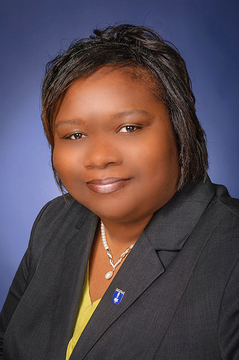
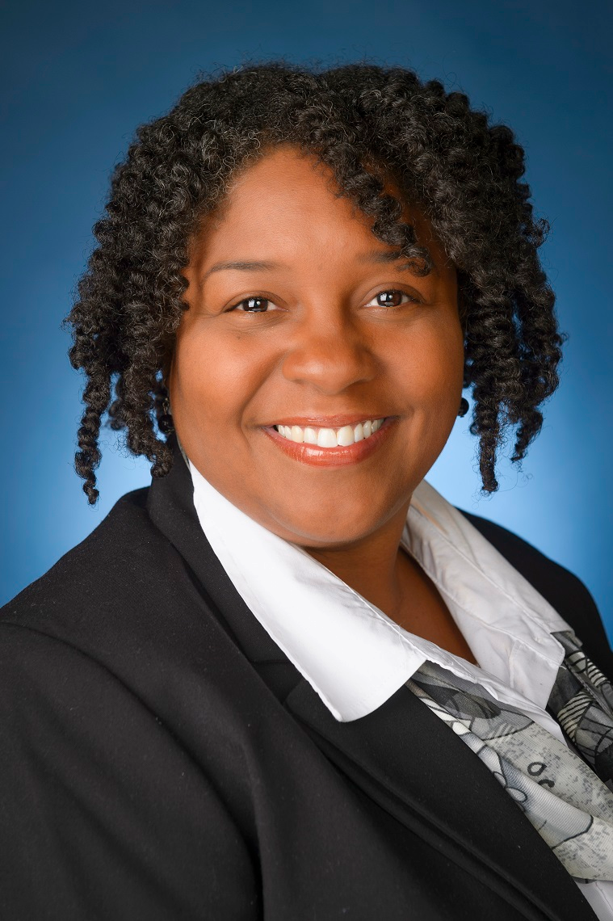
Department of Social Work
Faculty Introductions

Slide 6
Communication

Slide 7

Communication
Email
eCourseware
Website
Departmental Facebook Page
Volunteer and Job Postings
Handbook
Checking Campus Email
Rollover to personal account***

Slide 8

Communication Tools
Campus E-mail – Check Regularly & Update
Rollover to personal account: iam.memphis.edu Identity Management System
Student information cards.

Slide 9
Social Work Student Handbook
Preface:
Provides overview of the undergraduate social work program.
Helps you determine if social work – as a major and career option – is for you and your long term goals.
Guide as you progress through the social work major
We welcome you to the Department of Social Work and wish you a meaningful experience in the program and profession.

Slide 10
Professional Communication
Communicating with:
Professors
Peers
Class
Written communication
What to do when there is miscommunication…

Slide 11

Communicating Effectively
Positive professional relationships are the basis of the helping process.

Slide 12

Communicating with Your Professor
Communication between students and professors is professional communication and should encompass the same professional respect that you would give a client.

Slide 13

Written Communication
It is important that when someone reads your writing the reader understands what you mean and there are no spelling or grammatical errors.

Slide 14


Teamwork
Learning how to work in teams is an important skill for social workers.

Slide 15


Non-Verbal Communication
If your nonverbal messages conflict with your verbal message, the nonverbal message is more likely to be believed.

Slide 16

Professional Communication Guidelines
Be courteous and respectful.
Be a good listener.
Have an open mind.
Use a soft start-up.
Use “I” statements.

Slide 17
The formula for an “I” statement is:
“I” feel (state your emotion; angry, sad, concerned, etc.) when you (describe specific behavior in a neutral and objective way) because … (state the effect on your life).
I want… (state the action you want taken).
https://www.youtube.com/watch?v=Kj4ZZ3-6GCQ
Notes:
You Versus I Statements (3 min) https://www.youtube.com/watch?v=Kj4ZZ3-6GCQ

Slide 18
Professionalism

Slide 19

Social Workers are guided by a Code of Ethics
A professional Code of Ethics protects the welfare of the public from harm that can be done by social workers who act unethically. The public has a right to expect the highest degree of integrity from members of the social work profession.

Slide 20


Professional Boundaries
Boundaries distinguish professional relationships from social or personal relationships.

Slide 21
What does appropriate classroom etiquette look like?
Come to class on-time.
Put your cell phone away!
Come to class prepared to participate.
Follow directions for course assignments.
Reread all assignments before turning them in to check for spelling and grammatical errors.

Slide 22

Your Reputation and Your Career are related!
Protect your personal information visible on the internet.
Show respect and kindness to everyone.
Go beyond what's expected of you.
Be honest always.
Keep your commitments.

Slide 23
Advising and Registration
Prof. Brandon Ousley

Slide 24
Advising and Registration
UM Degree
Academic Advising
Planning for Graduation (http://www.memphis.edu/socialwork/pdfs/badegreesheetfall2016additionof20111.pdf
Unofficial Transcript
Intent to Graduate
CAMPUS for getting scheduled for advising
Advisor Preference

Slide 25
Curriculum and Sequencing of Courses

Slide 26
Curriculum
Information form for the major
Minors
DCS Stipend Program
Non-profit Leadership Certification
School Social Work Licensure
Honors Programming

Slide 27
Curriculum
http://www.memphis.edu/socialwork/pdfs/sequenceofclassesupdateadded20111.pdf
Course sequencing

Slide 28
Service Learning in Classes
SWRK 2010 – Placed at an agency. This is a generalist practice service learning where they are learning the roles of SW in community programs. They do 3o hours and present on their experience.
SWRK 2911- Must complete a practice experience where you identify social work policies in practice at a local agency and present experiences and findings.
SWRK 3903- In this class they do 50 hours and have to employ some of the techniques learned in the skills class into their experience. Again there is a final presentation.
SWRK 3904 – Student practice group skills in a 4 group sessions (group based work) intervention in the local SCS and a few Charter school locations. It is a simple support group, processing group, and social skills group for middle schoolers.

Slide 29
Time Management

Slide 30

What Is Time Management?
Knowing how to use your time effectively.
Avoiding procrastination.
Being organized.
Knowing yourself, your habits, your goals, and what times in the day you are most productive.

Slide 31

Suggestions
Record assignments – at the end of the first week of the semester, review your syllabus and write down all assignments in one place.
Study in one hour blocks.
Select an organized and quiet place to study and complete assignments.
Keep track of all commitments.
Create “To Do” lists.

Slide 32
Self Analysis
What are your goals for school and your career?
Are your goals achievable?
Do you genuinely want to achieve these goals?
Anticipate difficulties you may encounter.
Devise a strategy for overcoming difficulties and reaching your goals.

Slide 33
If You Are In Need Of Additional Support (cont.)
Main Campus:
Counseling Center
214 Wilder Tower
Fall/Spring: Monday-Thursday 8:00 a.m. – 7:00 p.m.
Friday 8:00 a.m. – 4:30 p.m.
Summer: Monday – Friday 8:00 a.m. – 4:30 p.m.
Telephone: 901.678.2068

Slide 34
Student Success Services

Slide 35
Student Success Services
Writing Center
ESP
Library
Counseling Center
eCourseware
APA
Plagiarism

Slide 36
Field Placement Procedures
Prof. Kenya Anderson

Slide 37
Field Placement Procedures
Field Manual
NASW Liability Insurance/ Membership

Slide 38
Field Placement Procedures
Field manual
Bachelor of Social Work handbook for Field Practicum
http://www.memphis.edu/socialwork/undergraduate/index.php
Field Forms
Purpose of Field Placement
Opportunity to test, through practical experience, the knowledge and skills acquired in academic courses.

Slide 39
Field Placement Procedures
After completing all 2000 & 3000 level required SWRK courses:
Mandatory: Attend Field Forum during semester prior to start of field. * Receive Field packet.
Schedule an appointment via CAMPUS to meet with Prof. Anderson regarding potential field placement assignment
Upon receiving potential assignment, contact agency within 2 business days to schedule an interview
Following your interview, complete and return the “Student Response to the Interview” form; the agency will complete and return the “Agency Response to the Interview” form
Purchase your NASW student membership and liability insurance – provide a copy of your liability insurance to Prof. Anderson (you cannot begin your internship until Prof. Anderson has received a copy of your liability insurance)
Attend Field Orientation

Slide 40
NASW & Liability Insurance
NASW
www.socialworkers.org
Ph: 800-742-4089 or 202-408-8600
Student membership costs $57
Liability Insurance Coverage
In order to begin field placement, the student must purchase liability insurance coverage. The minimum coverage to be purchased is the 1,000,000/5,000,000 option. The student must provide a copy of his/her certificate of coverage to the Director of Field Placement, verifying that the insurance is in place before the student can engage in any field activities.
Since the student is also required to join NASW, the professional organization for social workers, it is likely most cost effective for the student to purchase the liability insurance through the company contracted with NASW to provide such coverage. That company is:
The NASW has now formed their own malpractice insurance group called the NASW Risk Retention Group or RRG. To obtain liability insurance, please follow the following steps:
1. Purchase a student membership from NASW - www.socialworkers.org
2. Go to www.naswasi.cphins.com
3. Select apply online and follow the directions
4. Please call 1-855-385-2160 if you have questions or encounter difficulty with the online process
The NASW offers only one option for students, the 1,000,000/5,000,000 option and it costs $15 for a one-year membership. This is much cheaper than the previous rate.

Slide 41

MSW Program
Dr. Susan Neely-Barnes
MSW Program Coordinator

Slide 42
Why continue on to the MSW program?
Advanced Standing: Just 3 semesters to obtain an MSW
Or Part-Time Advanced Standing: 2 years Part-Time School
Regular Full-Time, Part-Time, and Distance Education Options
Advanced study in working with Children, Youth & Families or Adults and Families

Slide 43
Advanced Standing Eligibility
Overall GPA of 3.0
GPA of 3.3 in Social Work courses
Graduate from CSWE accredited bachelor program in the last 5 years.

Slide 44
How to Apply
http://www.memphis.edu/socialwork/graduate/deadlines.php
Apply to Graduate School ($35)
Take the GRE
Submit your transcripts (automatically done for you, if your transcript is from UofM, free)
Apply to MSW Program

Slide 45
MSW program application
Current Resume. Include all paid and non-paid social work experience.
Three Letters of Recommendation. You may submit a social work recommendation form in lieu of the letter.
Professional Goal Statement. Answer the following questions (maximum 2 pages for each question):
-Choose and describe a current social problem. How can social workers address this problem? What are the ethical considerations that must be kept in mind in addressing this issue?
-What significant life experiences or circumstances have influenced the development of your interest in social work? What are your social work related career goals? If you have trained or worked in another field, why are you considering changing your career?

Slide 46
GRE details: how to register
The University of Memphis Prometric Center 111C Brister Hall Phone: 901-678-1457
Or Online at http://www.ets.org/gre/
Have your GRE scores sent to
Graduate Admissions The University of Memphis 101 Wilder Tower Memphis, TN 38152-3520
Take the exam by December of the academic year you plan to graduate

Slide 47
GRE Fee Reduction Certificate
50% of fee waived ($97.50)
Financial Aid Office, 103 Wilder Tower
Must have completed FAFSA
http://www.ets.org/gre/revised_general/about/fees/reductions
http://www.memphis.edu/financialaid/pdfs/grefeereductionrequest.pdf

Slide 48
Questions?
Cherry Malone, MSW
678-3515 / 678-2981 (fax)
114 McCord Hall
ccmalone@memphis.edu
MSW Admissions Coordinator

Slide 49

Accreditation and Licensure
Prof. Kenya Anderson
Board of Social Workers, West TN
Licensed Master Social Worker
Representative

Slide 50
Accreditation/ Licensure
Competency Evaluations
Pathways to Licensure

Slide 51

Objective:
Provide brief history, composition and functions of TN Board of Social Work

Slide 52
ASWB
State of TN Board of Social Work is a member of the Association of Social Work Boards
An information forum, develops and maintains the licensing examinations.
ASWB is composed of social work regulatory bodies in 61 jurisdictions (49 states, 10 Canadian provinces and Virgin Islands) Guam newest member. CA rejoining.
Membership consists of state boards and provincial colleges that regulate social work practice.
Member boards govern the association through the ASWB Delegate Assembly.

Slide 53
ASWB: Connecting You to the Board
Pathway to Licensure
Social Work Registry
Approved Continuing Education (ACE)
Education Meetings
Practice Test
Study Guides
Online Practice Exams
Public Protection Database

Slide 54
Licensed Baccalaureate Social Worker, LBSW
Education: Baccalaureate Degree (CSWE Accredited Social Work Program)
Practice: Generalist
ASWB Exam: Bachelor’s Licensing Exam
Examples: Geriatric, Case Management, Senior Services

Slide 55
Board Administrative Staff
Supports the Board
Issues licenses to qualified candidates
For questions or to contact this Board:
Call (615) 741-5735 local or 1-800-778-4123 nationwide
Or Write:
ATTN Alice “Christi” Stacey, Board Administrator
Tennessee Department of Health
Health Related Boards, Department 665 Mainstream Drive, 2nd Floor Nashville, TN 37243

Slide 56

Thank You……
For your time and attention…
Kenya Anderson, LMSW
117 McCord Hall
Memphis, TN 38152
901-678-3400

Slide 57



Questions?

