Slide 1


Slide 2
Fulbright Scholar Program Opportunities
Dr. Catherine Martin Rebecca Laumann
Professor (Retired) Interim Executive Director
University of Memphis Center for International Education Services
March 29, 2019
UC 234, Memphis, TN

Slide 3



INTRODUCTION
The Fulbright Program
Established 1946 to expand and strengthen the relationships between the people of the United States and citizens of the rest of the world
Sponsored by U.S. Department of State’s Bureau of Educational and Cultural Affairs and administered by the Institute of International Education’s Council for International Exchange of Scholars (CIES)
Notes:
Photo Caption: Left- Dr. Joseph Withey, Associate Professor of English, East Carolina College, Greenville, North Carolina, discussing a planned book on Burmese dancing and dramatics with Kenneth Sein, one of Burma's leading dancers, during his Fulbright Research Scholar grant from July 1960-June 1961. Right: Linda Chamerlain, Adjunct Professor at the University of Alaska and Director/Public Health Scientist, Alaska Family Violence Prevention Project, was a 2014-2016 Fulbright Arctic Scholar.

Slide 4

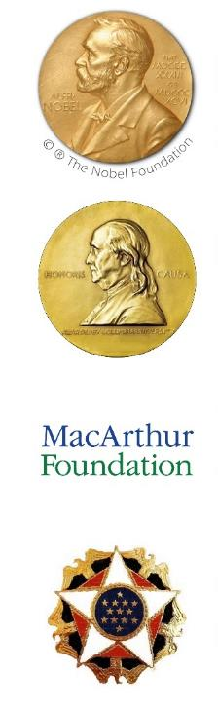
INTRODUCTION
Fulbright in Numbers
380,000+ Fulbrights awarded since 1946 800
U.S. Scholar grants annually
160
Participants countries
37
Heads of State or Government
59 Nobel Laureates
84
Pulitzer Prize recipients
71
MacArthur Fellows
16
Presidential Medal of Freedom recipients

Slide 5
INTRODUCTION
Diversity and Inclusion
Fulbright strives to ensure that it reflects the diversity of U.S. society and societies abroad. We encourage the involvement of people from traditionally underrepresented audiences in all our grants, programs and other initiatives.
Opportunities are open to people regardless of their race, color, national origin, sex, age, religion, geographic location, socioeconomic status, disability, sexual orientation or gender identity.
Notes:
Create talking points.
This also includes VETERANS
Candidates who have served in the Armed Forces of the United States will be given preference, provided their qualifications are approximately equivalent to those of other candidates.

Slide 6
U.S. SCHOLAR PROGRAM
Fulbright U.S. Scholar Program
Fulbright U.S. Scholar Program
International Education Administrator Seminars
Collaborative Research
93% Fulbright US Scholar Program
7% IEA Seminars
Percentage of U.S. Scholars
2018-2019

Slide 7
U.S. SCHOLAR PROGRAM
Eligibility for U.S. Scholar Programs
U.S. citizenship
Degree as required by award
Ph.D. or other terminal degree may be required
Many awards are open to applicants with a Master’s and professional or academic experience
Recent Master’s degree recipients and undergraduate degree holders are eligible for the Fulbright U.S. Student Program
Open to professionals and artists outside academia with recognized standing and substantial accomplishments
Teaching experience as required by award
Candidates who have served in the U.S. Armed Forces are encouraged to apply
New policies on previous Fulbright Scholar grants and waiting periods between grants
Notes:
Degree as required by award
Ph.D. or other terminal degree may be required
Many awards are open to applicants with a Masters and professional or academic experience
VETERANS
Candidates who have served in the Armed Forces of the United States will be given preference, provided their qualifications are approximately equivalent to those of other candidates.

Slide 8
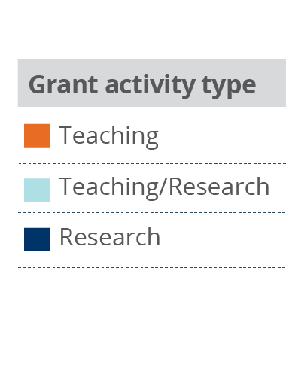
U.S. SCHOLAR PROGRAM
Fulbright U.S. Scholar Program
Supports teaching and/or research for two to 12 months
Programs active in +130 countries
For faculty, administrators and professionals
Open to all disciplines
Apply to specific award with proposed project
Application deadline: September 16th
Variety of host institutions
41%
20%
Percentage of U.S. Scholar Activity
2018-2019
39%

Slide 9
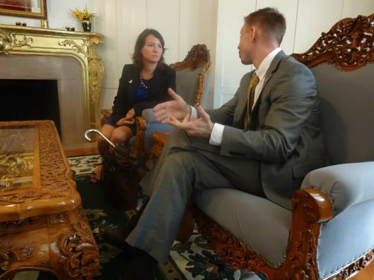
U.S. SCHOLAR PROGRAM
Fulbright Public Policy Fellowship
Opportunities for early and mid-career professionals and practitioners to Peru, Burma, Cote D’Ivoire, Ukraine
Placed in a host country Ministry in a range of public policy areas. Affiliations with host ministries recommended and negotiated by U.S. Embassy
Undertake an independent research project that focuses on a public policy-
related issue
Applicant profile: Graduate degree in a
field applicable to public policy and 3-5 years of relevant full-time work experience
Grant length: 4-9 months
Application deadline: September 16

Slide 10

U.S. SCHOLAR PROGRAM
Fulbright Program Process
What do you want to do and/or where do you want to go?
Develop project and identify location
Apply
Peer Review and Selection
1
2
3
4
5

Slide 11
U.S. SCHOLAR PROGRAM
Selecting the Right Award
Match your expertise, experience and proposal to the award description
Regional experience and language ability
Discipline preferences listed in the award
Relevance of the project to the country; why will host country benefit from your project?
Career level - early career, postdoctoral, mid-level, Distinguished Chair

Slide 12
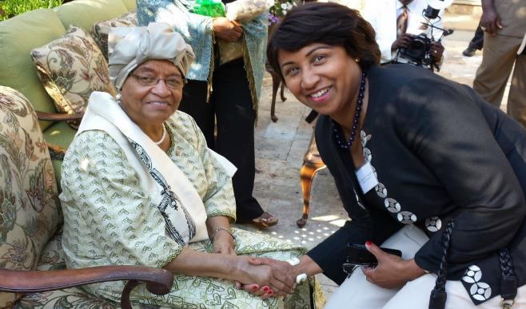
U.S. SCHOLAR PROGRAM
A Fulbright that Works for You
Flex option
Available in approximately 63 countries and 2 world areas
Allows multiple visits over two years
Awards throughout your career:
Postdoctoral awards
Early Career
Distinguished Chair
Multi-country awards
Global Scholar Award
Home university affiliation is not required. Applications from artists and professionals, independent and emeriti scholars are welcomed!

Slide 13
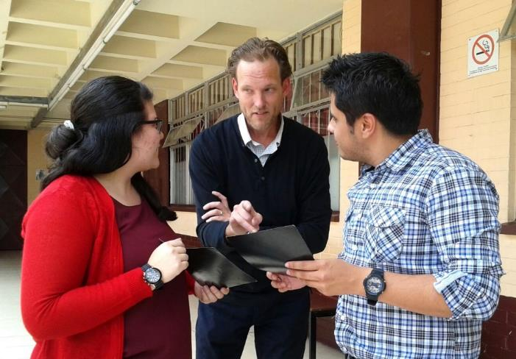
U.S. SCHOLAR PROGRAM
Application Resources
Fulbright Scholar Program website and Catalog of Awards
Apply
Application and Application Instructions
Application Guidelines, Project Statement Guidance and Samples
Learn
Webinars
The Fulbright Scholar Blog
Connect
MyFulbright

Slide 14
U.S. SCHOLAR PROGRAM
Application Components
Application Form
Project Statement
Curriculum Vitae or Resume
Letters of Reference
Additional components, depending on award
Course Outlines or Syllabi (for teaching awards)
Select Bibliography (for research awards)
Language Proficiency Report
Letter of Invitation
Supplemental materials for applicants in the Arts, Architecture, Writing and Journalism

Slide 15
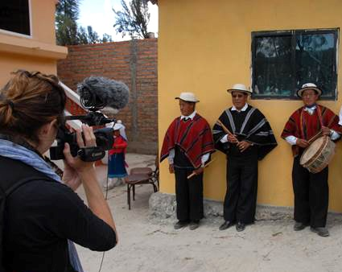
U.S. SCHOLAR PROGRAM
Project Statement
Your opportunity to lay out your proposed project specifics in as much detail as possible
Why Fulbright and why this country/institution/organizations?
Focus on what you plan to do; the specific courses you plan to teach/the methods and goals of your research
Outcomes from the grant - impact on hosts, home institution and you
How adaptable are you? How well will you deal with challenging situations?

Slide 16
U.S. SCHOLAR PROGRAM
Affiliations and Invitations
Host Institution:
If a host is identified, it will be found under Location in the Catalog
When a host is not identified, there are several resources to help find an affiliation:
International office on your campus
U.S. and Visiting Fulbright Scholar Directory
Review award description for suggested hosts or resources
Letter of Invitation:
Non-binding expression of interest from proposed host abroad
Should come from person with whom you will be collaborating
Should be on host institution letterhead

Slide 17
U.S. SCHOLAR PROGRAM
Submitting a Competitive Application
Address the Fulbright goal of promoting mutual understanding
Why you are interested in a Fulbright and why in your proposed host country
Professional expertise and skills you can offer; benefits to the host institution and host country; exchange of knowledge and experience
Cultural diplomacy; demonstrated flexibility, adaptability
Outcomes, impact, and multiplier effect
for your professional development, home campus, students, field at large; for your host institution
future collaborations; linkages: personal, professional, institutional; plans for sustaining relationships
internationalizing campus and curriculum

Slide 18
U.S. SCHOLAR PROGRAM
Review Process and Timeline
SEPT. 16
Application deadline
SEPT.
Program staff conduct technical reviews for completeness
OCT. - NOV.
U.S. peer review
DEC..
Applicants notified of status - Recommended applications are sent to host countries and to the J. William Fulbright Foreign Scholarship Board
JAN. – APR.
Grantees notified of final approvals
MAY – onward
Grantees prepare for grants
Notes:
You’ve submitted the application. Now what? First stage: did you follow the instructions.
Next, your application will be reviewed by a peer review panel of discipline experts. In peer review, applicants are either recommended or not recommended for further consideration, and are notified of this outcome. [DO NOT MENTION THAT APPLICANTS CAN BE HIGHLY RECOMMENDED. THIS IS INTERNAL INFO ONLY.]
For applications that were recommended following peer review, the next stage is multi-pronged: there’s the in-country review, the Fulbright Foreign Scholarship Board review, and the US Department of State approval. Please note that we must have all three decisions before we can notify applicants of the final outcome – that is, whether or not they have been selected for a grant, or named an alternate.
You may be wondering what criteria are used to evaluate applications in the review and selection process, and we have this outlined on our website. Here is the super short version…
Ultimately, those reviewing the application expect you to demonstrate that you’re qualified and able to take on what you propose, that the project is sound and well-planned, that you can adapt the project if you need to (and you probably will need to), and that it will have an impact. You need to show that you’ve done your homework to prepare for this project, regardless of how much experience you have doing similar projects. Lastly, your Fulbright-iness. Coined by some of our peer reviewers, this gets at your willingness to engage with the community while on your grant – and it’s an important aspect that is unique to Fulbright.
Also, please remember that while your project statement needs to address the technical aspects that your peers expect, it still needs to be described in such a way that a layperson will understand easily.

Slide 19
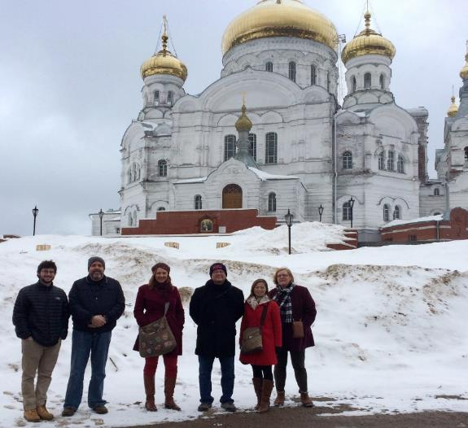
U.S. SCHOLAR PROGRAM
Administrator Seminars
International Education Administrator Seminars (IEA)
India – Aug. 1
Taiwan - Sept. 16
Japan, Korea- Nov. 1
France, Germany- Feb. 3
Russia Community College Administrators Seminar
Oct. 15
U.S. peer review committees discuss applications for a single geographical region

Slide 20
VISITING SCHOLAR PROGRAM
Visiting (Non-U.S.) Scholar Programs
Fulbright Visiting Scholar Program
Fulbright Scholar-In-Residence (S-I-R) Program
Outreach Lecturing Fund (OLF)
4% Scholar-In-Residence
Percentage
of Visiting Scholars
2018-2019
96% Visiting Scholar Program

Slide 21
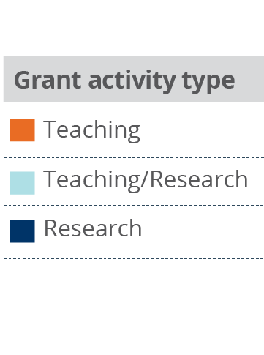
VISITING SCHOLAR PROGRAM
Fulbright Visiting Scholar Program
Purpose and Application
Visiting Scholars from other countries engage in research and teaching activities on U.S. campuses
Visiting Scholars apply through the Fulbright Commission or U.S. Embassy in their home countries
88%
2%
10%
Percentage
of Visiting Scholar Activity
2018-2019
Notes:
IIE/CIES issues DS-2019s for the all Visiting Scholars and their dependents, provide Scholars with J-visa compliant health benefits plan, offers Fulbright Enrichment Opportunities
Host Institutions provide access to libraries and work space, exposure to student body and institution community, and include scholars in on-campus cultural activities

Slide 22
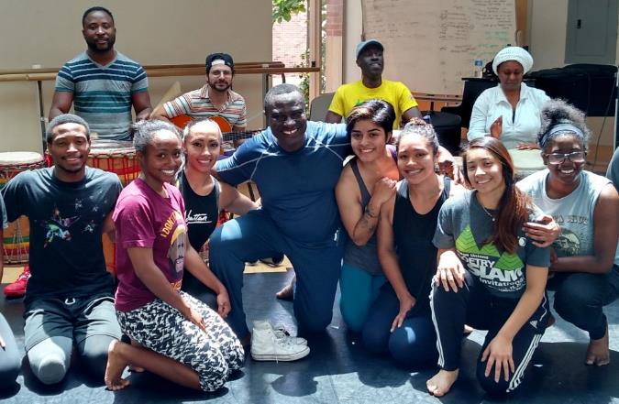
VISITING SCHOLAR PROGRAM
Scholar-In-Residence Program
Brings scholars and professionals from abroad to campuses that do not often host visiting scholars
Involves colleges and universities that serve student populations underrepresented in international exchange programs
S-I-R grantees
Primarily teach undergraduates
Provide cross-cultural/ international perspective
Application is made by the interested U.S. institution
1 semester or full academic year options
Deadline is November 1; Email: sir@iie.org
Notes:
Photo Caption: Benjamin Ayettey, a dance instructor from Accra, Ghana, was a Scholar-In-Residence at Ohio Norther University from 2015-2016.

Slide 23
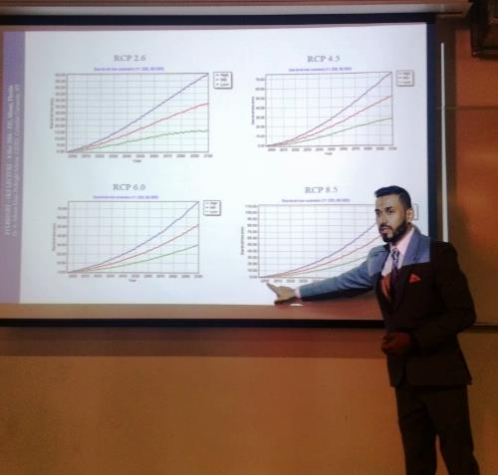
VISITING SCHOLAR PROGRAM
Outreach Lecturing Fund (OLF)
Travel grant for Fulbright Visiting Scholars already in the U.S. for short-term guest teaching
Institutionally driven application by U.S. Host Institutions
Scholars can meet, lecture and exchange ideas with
Faculty and students
Community organizations
K-12 schools
View the online scholar directory for a list of 900+ scholars who are
currently in country.
Email: olf@iie.org

Slide 24
FULBRIGHT FAMILY
Other Fulbright Programs
Fulbright Arctic Initiative
Collaborative research opportunity that brings together a network of scholars, professionals and applied researchers to research Arctic issues
Fulbright Specialist Program
Short term program that promotes linkages between U.S. scholars and professionals and their counterparts at host institutions overseas
Fulbright U.S. Student Program
Recent graduates, postgraduate candidates through dissertation level, developing professionals and artists to study and research abroad
Fulbright Distinguished Awards in Teaching Program
Principally for primary- and secondary-level educators
Fulbright-Hays Awards
Faculty research, group projects and seminars in designated social sciences and humanities fields

Slide 25



NEXT STEPS
Stay Connected to the Fulbright Scholar Program
Join MyFulbright at cies2.org
Email me at rlaumann@memphis.edu
Visit us at www.cies.org to learn more about the Fulbright U.S. Scholar Program
Refer your colleagues
The Fulbright Program @FulbrightPrgrm @the_fulbright_program

