Slide 1
UNIVERSITY OF MEMPHIS
INSTITUTE ON DISABILITIES (UMID)
Career Development &Transition Programs
College Campus Transition Program (CCTP)
and Tigers- Learning Independence, Fostering Employment and Education (LIFE)
Chrisann Schiro-Geist, PhD
Maurice Williams, MA,MS, CNP

Slide 2
College Campus Transition program/TigerLIFE

Slide 4
Career Development & Transitions Programs
TigerLIFE-Integrated Inclusive Model
PSE modeled after Think College recommendations.
Inaugural student cohort of eight ~ each student completed secondary education under an Individual Education Plan
CCTP-Hybrid Exclusive Model
Partnership with Local School District, and Regional Vocational Rehabilitation Agency.
Nine student cohort ~ each student recommended by SCS Teacher & DRS counselor.

Slide 6
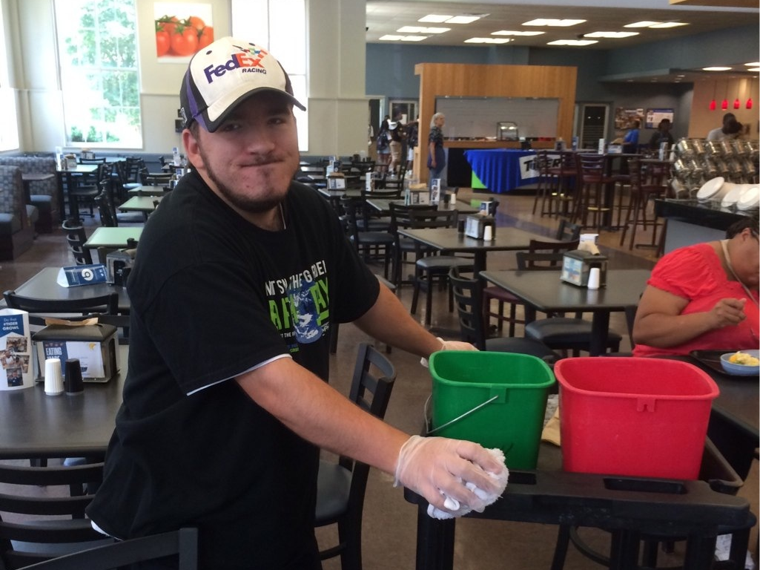

Slide 7
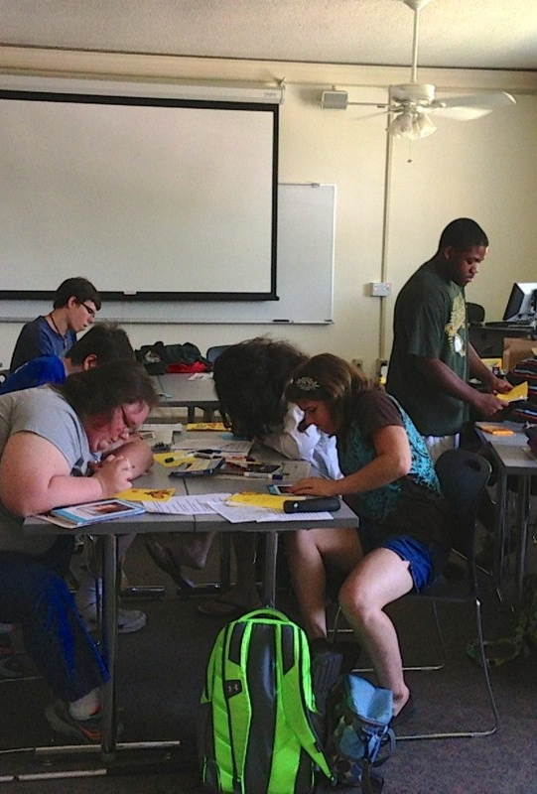
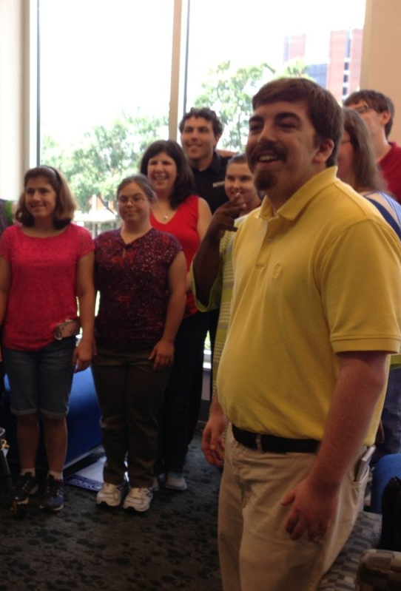
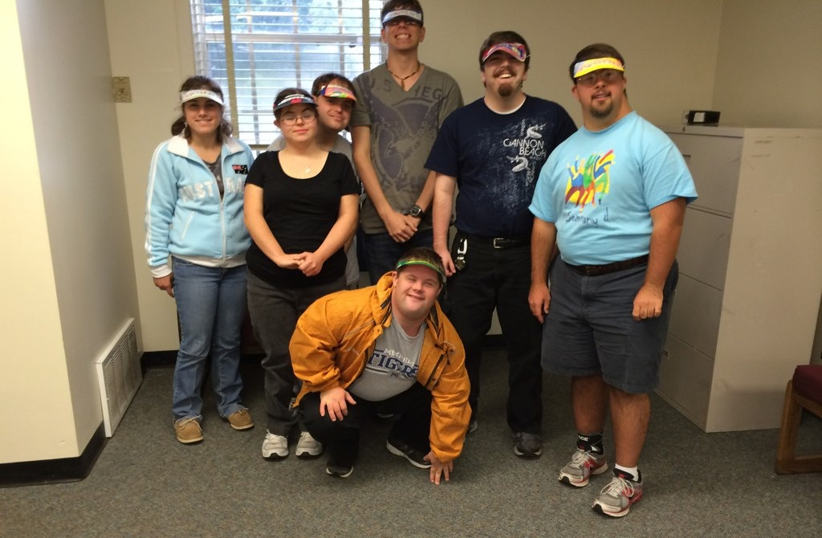
Classroom Learning Experiences

Slide 8
PSE Financial Information
Next Step - $15,000 year; FUTURE - $15,000 year; IDEAL- $15,000 year; TigerLIFE $ 4,950.00 per semester and EDGE $15,000 year
Financial Aid Opportunities:
STEP UP Scholarship: $3,500/year if enrolled in PSE within 16 months of graduating high school
Federal Financial Aid (FAFSA): Federal grants available for CTP program participants who have demonstrated financial need.
Program Scholarship Funds: Awards given per semester to students who demonstrate financial need (as available)Vocational Rehabilitation:
Transitional Service Learning Waiver – up to $2,400 in waivers per semester eligible.

Slide 9
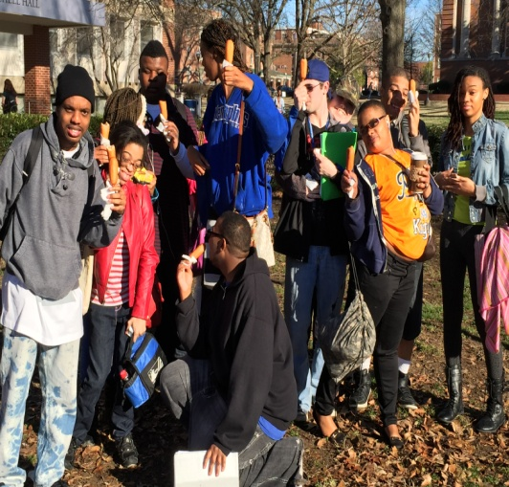
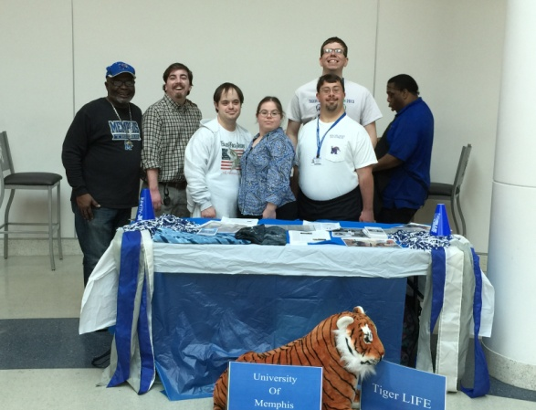
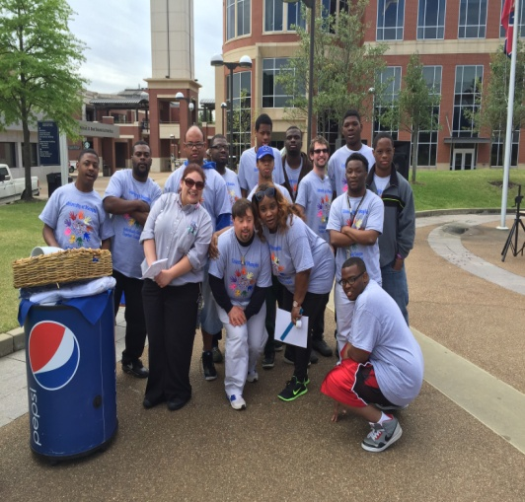
PSE Transition Programs University of Memphis – TigerLIFE
UMID PSE Transition programs provides an opportunity for students in West TN to develop the social and employment skills needed to transition successfully into adult independence.
PSE Transition at Memphis provides work based learning, job readiness and job placement opportunities.
A true experience in diversity with one of the most diverse student bodies in the State.

Slide 10
PSE Transition Programs University of Memphis – TigerLIFE
TigerLIFE Data
Original Pilot 8 cohort 100% retained and received completion certificate, 5 are currently employed and 3 are currently receiving job placement service while completing community employment based internships.
Fall, 2013 enrollment 25.
Fall, 2014 enrollment 49.
Fall 2015, enrollment 79, with 19 slated for completion in December; 22 ready to enroll spring 16, plus 12 CCTP dual enrollment students, enrolling, spring 2016.
TigerLIFE is predicting a fall 2016 enrollment of 100 students.

Slide 11
UMID - tigerlife
TigerLIFE Data
Employment internships
University Libraries; The Highlands of Memphis Nursing services; Economic Opportunities (ECOP) Logistics Warehouse Certification (CRP), Milestones Environmental Health and Safety Training and Walgreens Job Placement (CRP). All TigerLIFE students complete the program with their Shelby County Food Handlers certification .
Academic Inclusion
Freshman Level - American Government, World History Criminal Justice, Spanish, Intro to Business Hospitality, Intro to Anthropology and 2000 Level Health and Physical Science.
Social internships include
TIGUrS Garden, University Veterans Center, Multicultural Festival Volunteers, Student Ambassadors Board Volunteers, University, Health Education and Campus Ministries.

Slide 12
Future Plans TigerLIFE
TPSID Award 2015
BRIDGE
2015 -2020 – TigerLIFE will work with the BRIDGE Project to produce data to support research in four discipline areas that provide intervention support that facilitates strong inclusive habits in persons with I/DD.
Master /Doctorate level graduate practitioners in the following areas
Counseling Educational Psychology and Research
Behavioral Assessment
Social Work
Rehabilitation Counseling
Rehabilitation and Disability Services
Instruction Curriculum Leadership

Slide 14
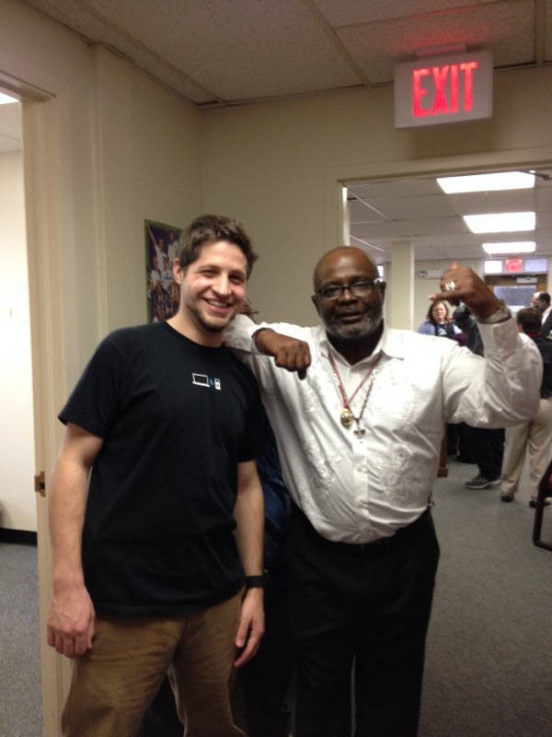
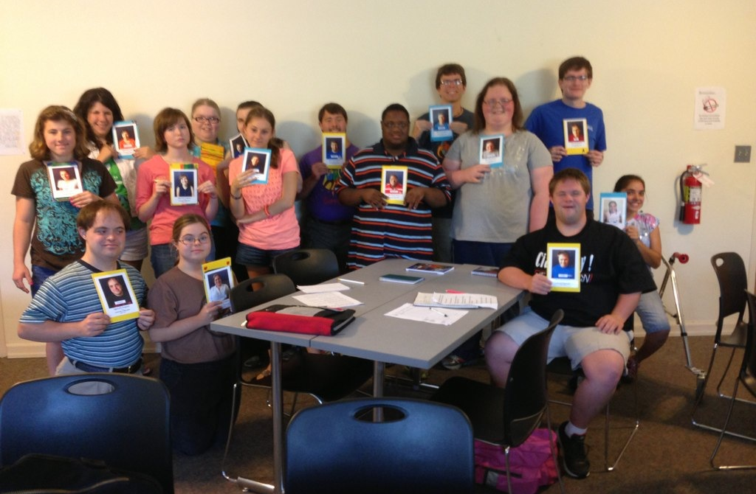
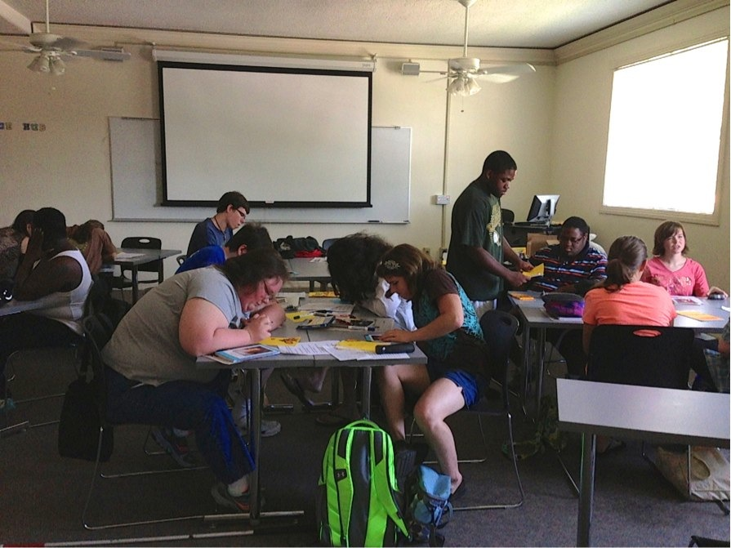

Slide 15
Learning Job Skills

Slide 16
On the Job Training

Slide 17
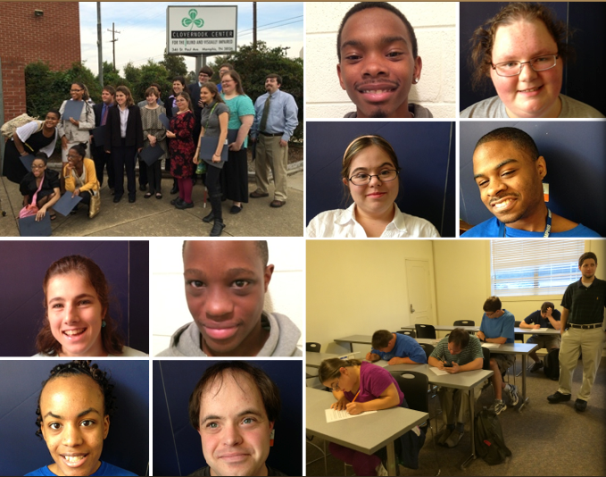
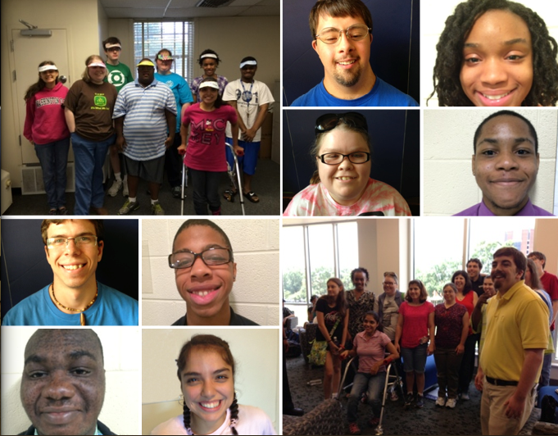

Slide 18
Go Tigers!

